Slide 1

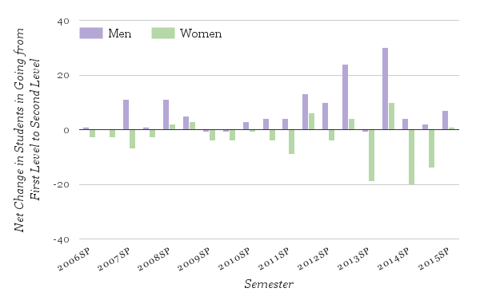
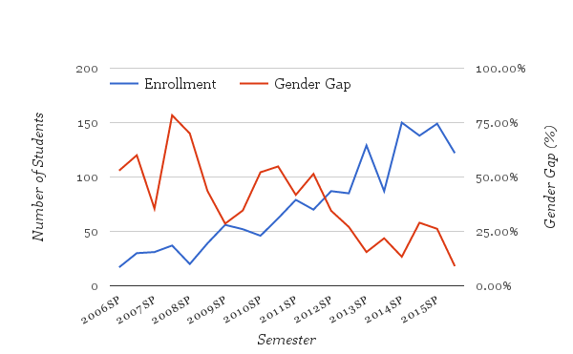
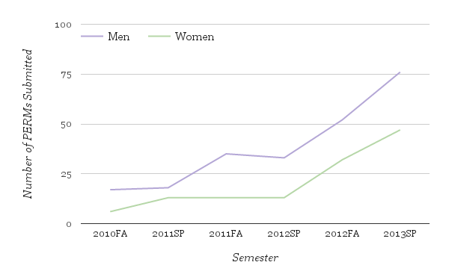
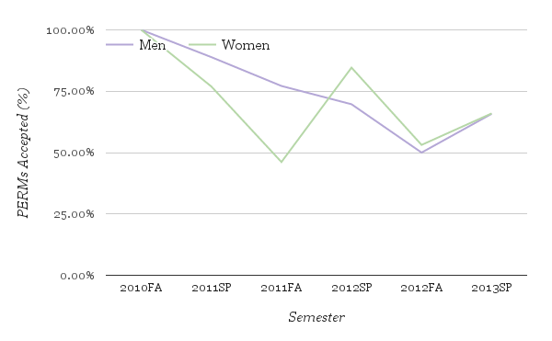
Forcing Out Female Students?
Effects of Enrollment Pressures on Undergraduate Women
in Computer Science
Christina Tong (‘17), Jennifer Nguyen (‘17), Anastasia Voloshinov (‘17),
Maya Man (‘18), Alia Buckner (‘18), Katie Li (‘18), Maria Martinez (‘17) Department of Computer Science, Pomona College
______________________________________________________________________________
PROBLEM & HYPOTHESIS
Why, despite increased recruitment efforts, do we not see more women receiving CS bachelors? We investigate increasing undergraduate CS enrollments, which have risen nationwide by 32% since 2007 [6], as a possible cause. We hypothesize that enrollment pressures compound the existing factors that discourage women from pursuing CS. We predict that rising enrollments create a hyper-competitive environment that favors those who have prior experience in or high commitment to the field of computer science.
RESULTS
BACKGROUND & RELATED WORK
Existing factors that discourage women in CS include:
Less computing experience [4];
Impostor syndrome [5];
Less likely to be planning to major in CS [5][7].
PERM: A “PERMission to enroll” request asking to be placed on a course’s waitlist
The Intro CS Sequence at Pomona College: Students take one of two First Level course (CS 51, CS 51G), followed by both of the Second Level courses (CS 52, CS 62) in any order
Figure 1. “Retention” rates for females between First and Second level courses are low but improving
Figure 2. The gender gap has decreased as enrollments have increased.
EXPERIMENTAL DESIGN
Focus on Pomona College’s CS Department because:
Since 2009, ~200% increase in enrollments
Female-friendly:
~50% of professors* and student TA’s are women
Mentoring program with the option to be in an all-women mentor group
Gender gap is far below the national average
Located in California’s technically-oriented job market
Data sets:
Anonymized roster information for 987 students in the intro sequence (Spring 2006 - Fall 2015)
Anonymized PERM data for 761 students in the intro sequence (Fall 2010 - Spring 2013)
Volunteer-based qualitative survey responses from 59 students (class of 2015 - 2018) who had enrolled in or tried to enroll in an intro sequence course.
Questions:
Is the gender gap increasing as enrollments increase?
Is there a significant difference in the numbers of men and women who submitted PERMs?
Is the percentage of PERMS accepted different for men and women?
Is there a difference in retention rates of men and women between the First and Second Level courses?
Do male and female students differ in their perceptions of departmental support?
* At the time of our initial research, 4 out of 8 CS faculty were female
Figure 3. Significantly more men than women submit PERMs, but equal percentages of PERMs are accepted.
DISCUSSION
The gender gap may be decreasing (Figure 2), but survey results revealed women are two times more likely (28% vs. 13%) to report not feeling adequately supported by faculty
Female survey respondents less likely to be planning on majoring in CS or to have prior exposure to CS
Survey respondents of both genders complained of “feeling like generic member[s] of the crowd” because “there are too few faculty members compared to [the] number of students”
Compare trends to other colleges’ CS departments
Determine the causes of and solutions to low female retention rates
REFERENCES
Cohoon, J. M. (2001, May). Toward improving female retention in the computer science major. Communications of the ACM, 44(5), 108-114. http://dx.doi.org/10.1145/374308.374367.
Gallagher, B (2012, December 27). No Women In CS? Well, Not For Long. TechCrunch. http://techcrunch.com/2012/12/27/stanford-bridging-gender-gap/.
Jacobson, L. (2015, March 3). Hillary Clinton says women earned twice as many computer science degrees in the 1980s as today. Retrieved March 19, 2015, from http://www.politifact.com/truth-o-meter/statements/2015/mar/03/hillary-clinton/hillary-clinton-says-women-earned-twice-many-compu/.
Powell, R. M. (2008, February 29). Improving the persistence of first-year undergraduate women in computer science. ACM SIGCSE Bulletin - SIGCSE 08, 40(1), 518-522. http://dx.doi.org/10.1145/1352322.1352308.
Scragg, G., & Smith, J. (1998, March). A study of barriers to women in undergraduate computer science. ACM SIGCSE Bulletin, 30(1), 82-86. http://dx.doi.org/10.1145/274790.273167.
Steed, S. (2013, March 8). Undergrad Computer Science Enrollments Rise for Fifth Straight Year. CRA Taulbee Report. http://cra.org/govaffairs/blog/2013/03/taulbeereport/.
U.S. Department of Education, National Center for Education Statistics. (2013). Table 325.35: Degrees in computer and information sciences conferred by postsecondary institutions, by level of degree and sex of student: 1970-71 through 2011-12. In U.S. Department of Education, National Center for Education Statistics (Ed.), Digest of Education Statistics (2013 ed.). Retrieved from http://nces.ed.gov/programs/digest/d13/tables/dt13_325.35.asp.
National Science Foundation, National Center for Science and Engineering Statistics. 2015. Women, Minorities, and Persons with Disabilities in Science and Engineering: 2015. Special Report NSF 15-311. Arlington, VA. http://www.nsf.gov/statistics/2015/nsf15311/tables/pdf/tab5-1.pdf.
ACKNOWLEDGEMENTS
We would like to thank Professor Tzu-Yi Chen for her invaluable support and guidance, and the Anita Borg Institute and Pomona College for the funding that allows us to attend the 2015 Grace Hopper Celebration.

